Slide 1


Energy Market Update
Q1 2026

Slide 2
Executive Summary
No news is good news! Prices steady with no significant price events, including during recent heatwave
More renewable energy entering the system, although coal largely stable
Energy demand has increased due to electrification, heating, population growth, data centres
Wholesale electricity prices subdued, which is flowing through to futures prices
Only one significant wholesale price spike (SA 2 July 2025) has contributed to reduced wholesale price volatility across the board
Stable domestic gas prices
Large Generation Certificate (LGC) prices tumble

Slide 3


Introduction
Mohsin brings over 20 years of experience in the energy industry, with a specialised focus of 15 years in energy procurement. During his career, he has gained comprehensive experience across the energy supply chain, having worked with energy retailers, consultancies, and brokers. Mohsin has successfully managed energy procurement for large national and international clients in Australia, New Zealand, and Singapore.
He possesses a deep understanding of the Australian energy markets and holds a Diploma in Financial Markets (Energy) from the Australian Financial Markets Association.

Slide 4
Market update explained
This ad-hoc report uses the following inputs:
Electricity spot price: In the National Electricity Market (NEM), prices are set every 5 minutes as the market operator balances bids from suppliers with demand
ASX Energy Futures: As the NEM spot price can be very volatile, futures provide a fixed price between a buyer and seller. As futures are eventually settled at the spot price, changes in spot prices affect futures. These futures prices eventually filter through to both large and small market electricity contracts
Gas prices: Since the development of LNG export facilities in Queensland, the east coast domestic gas price is often influenced by overseas prices. Furthermore, gas-fired generators often supply the NEM during peak periods, meaning the price of gas can affect the price of electricity
Market operators and regulators: This report uses publicly available data including, but not limited to, the Australian Energy Market Operator (AEMO), Clean Energy Regulator (CER) and the ACCC

Slide 5
Quarterly pricing trends
Electricity ($/MWh):
Source: ASX Energy
East Coast gas ($/GJ):
Electricity prices listed as based on the settled Base Strip (12-month) prices as of 23 January 2026, compared to the same settled price from three, six, nine and twelve months ago respectively
Gas prices are volume-weighted retail offers to large (min 0.5PJ pa) C&I as listed in the ACCC Gas Inquiry report December 2025
Source: ACCC Gas Inquiry 2017-2030

Slide 6
Flat ASX Energy futures
ASX Futures (FY Base Strip) – year ending 16 Jan 2026
Pricing relatively flat over the last year, starting to drop from November 2025 onwards
High renewable generation and lower price volatility has offset higher demand
Most significant reduction in NSW, likely driven by extension of Eraring (confirmed officially on 20 January 2026)
VIC FY29 higher than other years – impact of expected Yallourn closure
Source: ASX Energy

Slide 7
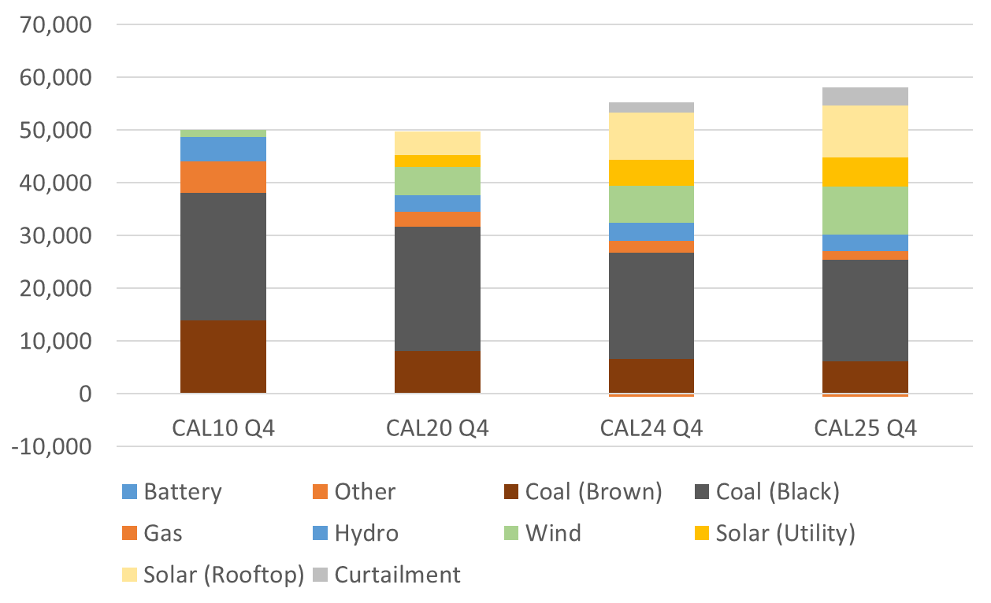
Renewables continue to power ahead, but coal steady
NEM energy generation by fuel type (GWh)
Renewable energy generation 48% of CAL25 Q4
Coal is largely stable from the previous year even as renewable generation is increasing – this means renewable generation is additive rather than coal replacement
Batteries will play an increasing ‘firming’ role in the grid as baseload coal retires
Source: OpenNEM (AEMO)

Slide 8
Recent electricity spot prices flat
NEM monthly spot prices (volume weighted by state)
Prices peaked in July 2025, while pricing also subdued during recent heatwave – a sign that the NEM could be moving from a summer to winter peaking system
This was driven by lower price volatility and increased generation (largely from renewables) to offset higher demand
Generally, around 18% of wholesale prices are negative (QED report)
Hydro continues to set most prices in the NEM, although wind, grid-scale solar and batteries are increasing their presence (QED report)
Source: OpenNEM (AEMO)

Slide 9
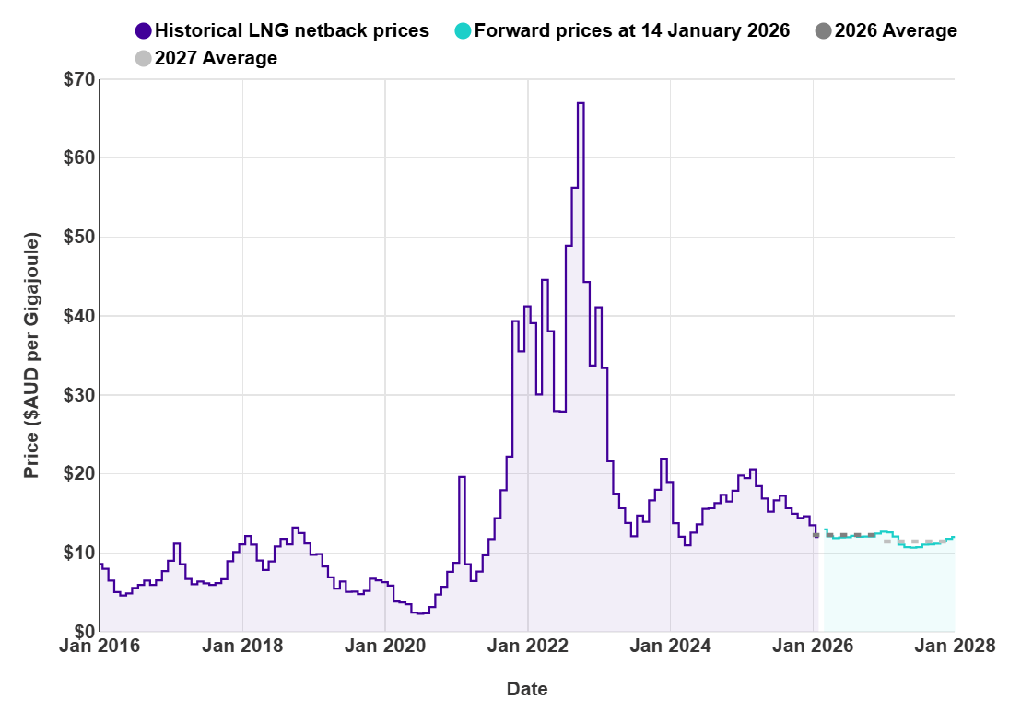
Stable gas prices
LNG Netback prices
Domestic prices relatively steady, with retailer prices reported at $13-15/GJ range for 2026 and $14-16/GJ range for 2027 (ACCC)
International prices (refer chart), which impact domestic prices, also steady
Reduced need for gas-fired power generation due to higher renewable output and fewer wind lulls (QED)
Reduced east coast gas production, although partially offset by reduced demand and increased storage use
Source: ACCC

Slide 10
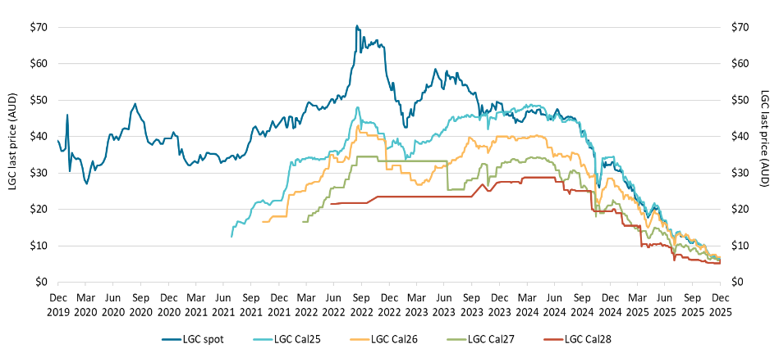
LGC prices fall significantly
LGC reported spot and forward prices – Q4 2025
LGC prices tumble across the board due to strong LGC generation from wind farms and ample capacity to meet the Renewable Energy Target (RET)
LGC scheme set to expire in 2030, to be replaced by the Renewable Energy Guarantee of Origin (REGO) scheme
VEEC prices rebounding since mid-November (spot price ~$80/cert)
Source: Clean Energy Regulator

Slide 11
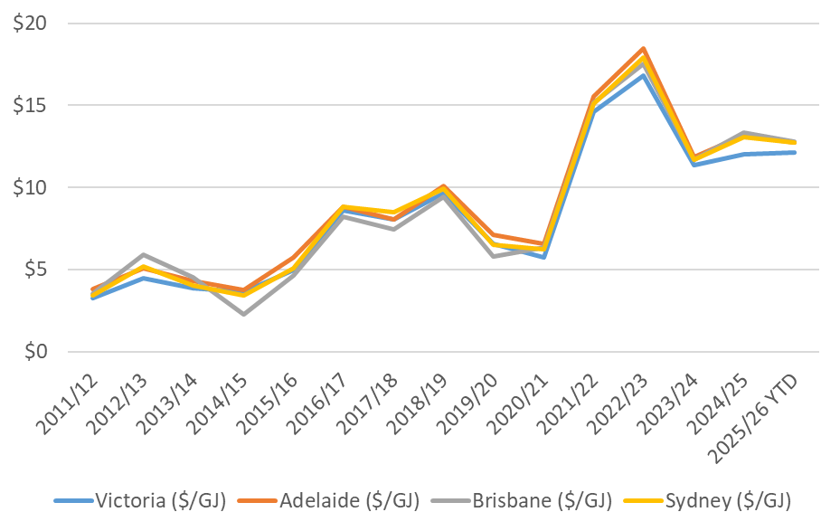
News: East coast gas reservation scheme on the way
Domestic gas prices began to increase following the commencement of LNG export prices in 2015 (refer chart) as gas producers could now have the option of supplying the (more lucrative) export market instead of domestic users.
As a result, domestic prices became increasingly linked to international prices.
Federal governments have made many interventions to limit the price increases. However, these have been limited as structural impediments remain (market concentration, long development process)
To address this, the Federal Government has announced an east coast reservation policy to apply from 2027. The policy is prospective, so will not affect existing gas producer contracts.
It is unclear what, if any, downward pressure this may apply to prices. Any benefits may be years away, while pricing too low may deter investment. Incentives need to be “just right”.
National gas balancing market prices FY11–FY26
Source: Australian Energy Regulator

Slide 12
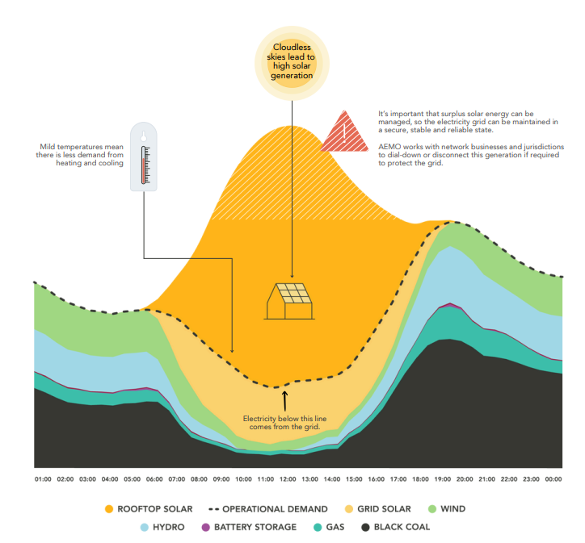
Other news
Concerns renewable energy won’t hit target at current pace
Federal Government proposes Solar Sharer Offer
The Federal Government has set a target of 82% renewable energy by 2030. Renewable energy currently sits at ~42%, and while this is a significant increase from previous years, there are concerns there are not enough new renewable energy projects being developed to hit the 82% target. Rystad Energy forecasts Australia will only hit 60 to 65% renewable energy at the current pace.
While the Federal Government has set up a Capacity Investment Scheme (CIS) to underwrite new projects, many projects awarded to date have yet to reach financial close. The reasons speculated for this include:
Winners of CIS rounds have bid in too low and need additional revenue
Delays in approvals, including for transmission lines
Difficulties in obtaining social licence
A Solar Sharer Offer has been proposed by the Federal Government that will offer $0/kWh during a specific window during the day.
The offer aims to reflect the abundance of energy during daytime hours when solar is most productive (see chart below), and likewise with presumably higher morning and evening peak prices. This proposal has gone to consultation, with Victoria following suit with their own proposal.
Energy ‘duck curve’
Source: Department of Climate Change, Energy, the Environment and Water

Slide 13
Other news
Cheaper Home Batteries wildly popular
Eraring closure delayed
Guarantee of Origin (GO) launches
175k applications expected, resulting in over 3.9 GWh usage by end of 2025 (more capacity than the five biggest utility-sized batteries combined). Over 6 GWh of batteries are expected to be installed by end of FY26
The closure of Origin Energy’s Eraring power station has been delayed from August 2027 to April 2029. This was not a surprise as there were concerns that not enough new supply was available to fill the gap from Eraring’s closure
Launched on 3 November 2025, it includes the Product Guarantee of Origin (PGO), which will track the origin, formulation and emissions intensity of hydrogen from electrolysis
Coalition abandons net zero by 2050
Federal Government to pass new environmental regulations
REGO also launches
As part of the above initiative, the Renewable Electricity Guarantee of Origin (REGO) is intended to substitute the LGC scheme once the Renewable Energy Target (RET) expires in 2030
The Federal Coalition has scrapped a commitment to reach net zero by 2050, although has decided to formally remain with the Paris Agreement
After reaching a deal with the Greens, Labor will pass new Federal environmental laws that they hope will speed up approvals of development, such as renewable energy projects

Slide 14
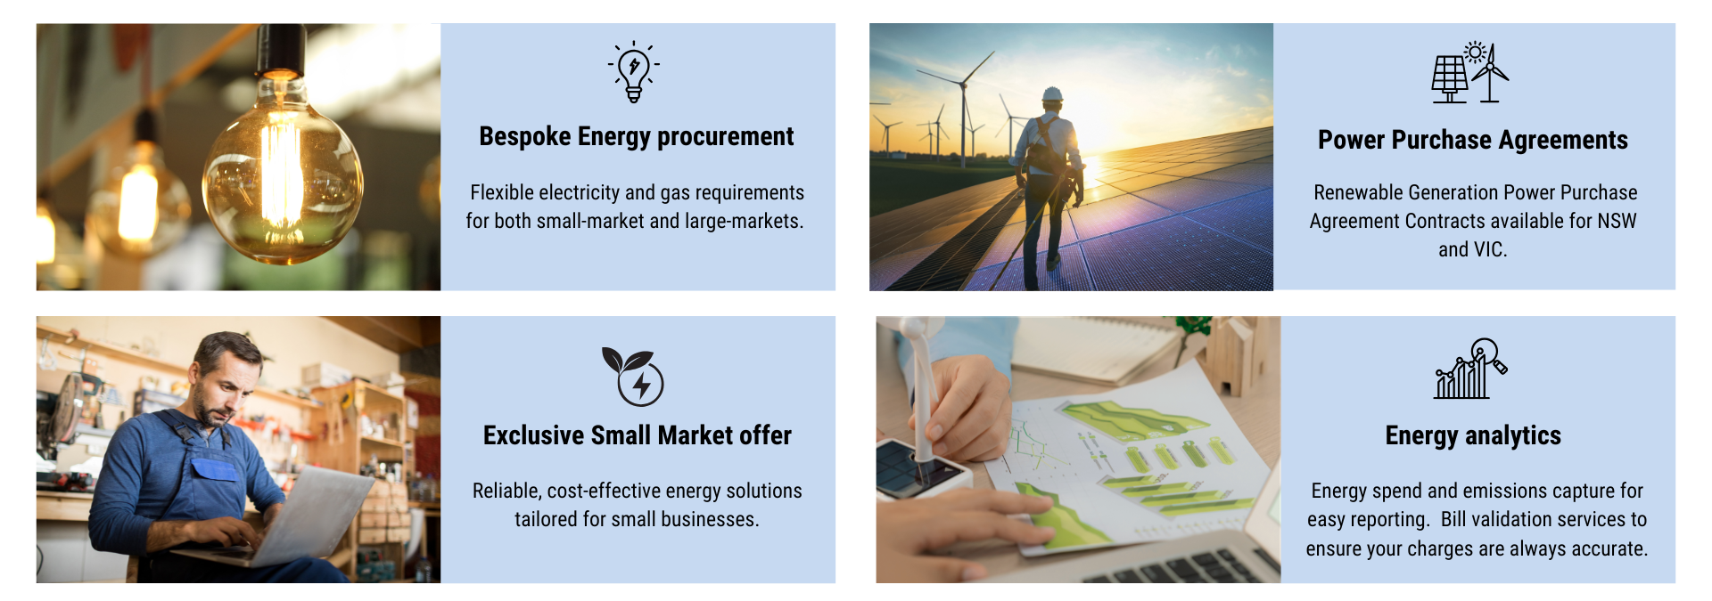
Energy Snapshot

Slide 15









Bespoke energy procurement
Key Features
Benefits
Collaborate on a procurement strategy tailored for your requirements
As one of the largest energy aggregators in the country, we have deep relationships with energy suppliers.
Market monitoring backed by industry expertise
Access to energy solutions, such as solar, batteries, electric vehicles and energy efficiency schemes
Rigorous energy supplier assessment with simple, easy to read reports
Green Power options as part of a tailored energy solution.

Slide 16






Exclusive Small Market offer
Key Features
Benefits
Rates available exclusively through Procurement Australia as a result of a competitive tender process
Very competitive energy rates, often 30% below comparable offers
Energy rates locked in until 2028, providing budget certainty
Dedicated customer service team
No exit fees, with unlimited roll-in capability. Minimum 10 sites across NSW, VIC, SA or QLD.
GreenPower options available

Slide 17







Power Purchase Agreements
Victoria PPA - Windfarm / NSW PPA - Solar
Key Features
Benefits
Stable pricing in both power and LGC costs across the life of the PPA.
Long term pricing certainity (up to 2032)
Access and flexibility to renewable energy included as part of a long-term energy plan via accredited GreenPower energy.
Generous load flex and load roll in allowances and portfolio level protection.
Participating users can meet their renewable energy targets through these agreements
Dedicated account managers

Slide 18
Sources
Open NEM
ASX Energy futures
ACCC Gas inquiry December 2025 interim report
AEMO Quarterly Energy Dynamics report
Clean Energy Regulatory Quarterly Carbon Market Report
Department of Climate Change, Energy, the Environment and Water Solar Sharer Proposal
Rystad Energy’s assessment of meeting 82% renewable energy target (published at WattClarity)
Australian Energy Regulator Gas market prices
Disclaimer: Procurement Australasia Ltd, trading as Procurement Australia, makes no representation and gives no assurance, guarantee or warranty as to the accuracy of information provided. All forward-looking statements are based on publicly available information and are estimates only and should not be relied upon without seeking further advice. To the maximum extent permitted by law, none of Procurement Australasia Ltd, its related companies, directors, employees, or agents will be liable for any loss arising from the use of information presented in this document or in connection with it.

